Slide 1
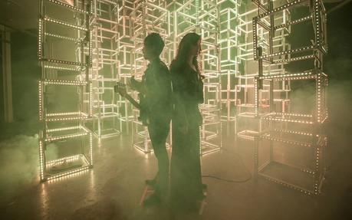
Coding for Concerts
Chris Piech + Alex Green + Kyle Fleming
CS 106B
Lecture 24
Mar 9, 2016

Slide 2

Today’s Goal
See “real” C++
Be inspired

Slide 3
Special Guests

Slide 4
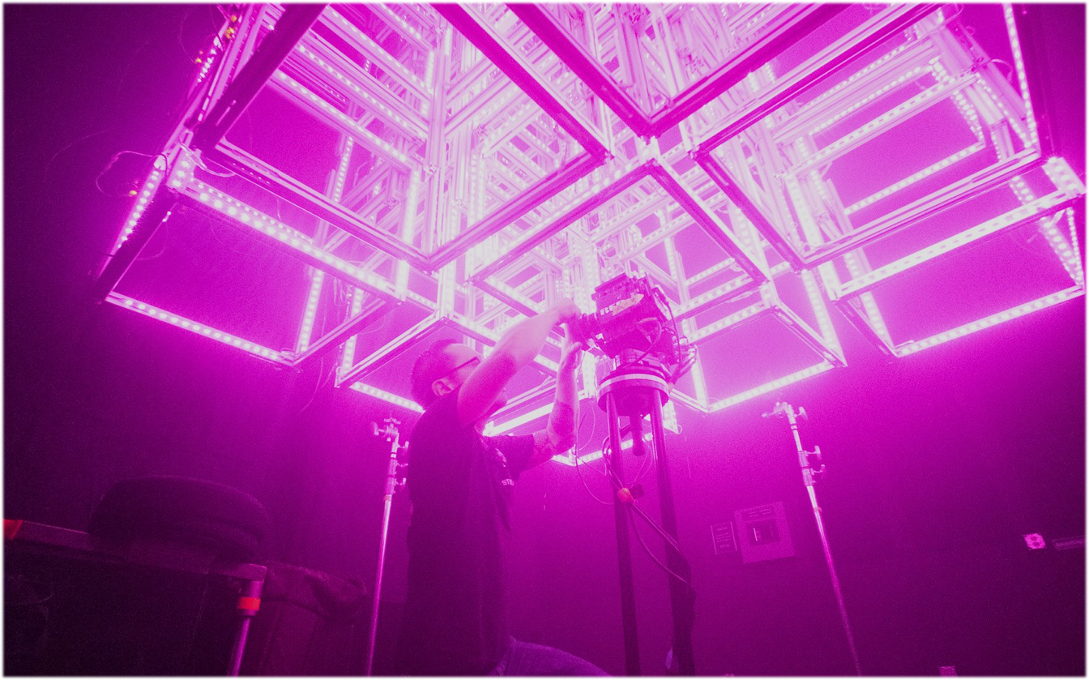
Symmetry Labs
The Future of Lighting
An integrated platform for software controlled lighting
Notes:
VISION
We’re building
responsive lighting software + content platform
high-end programmable fixtures
Purpose
Says what we are making in a palatable form, and for whom.

Slide 5
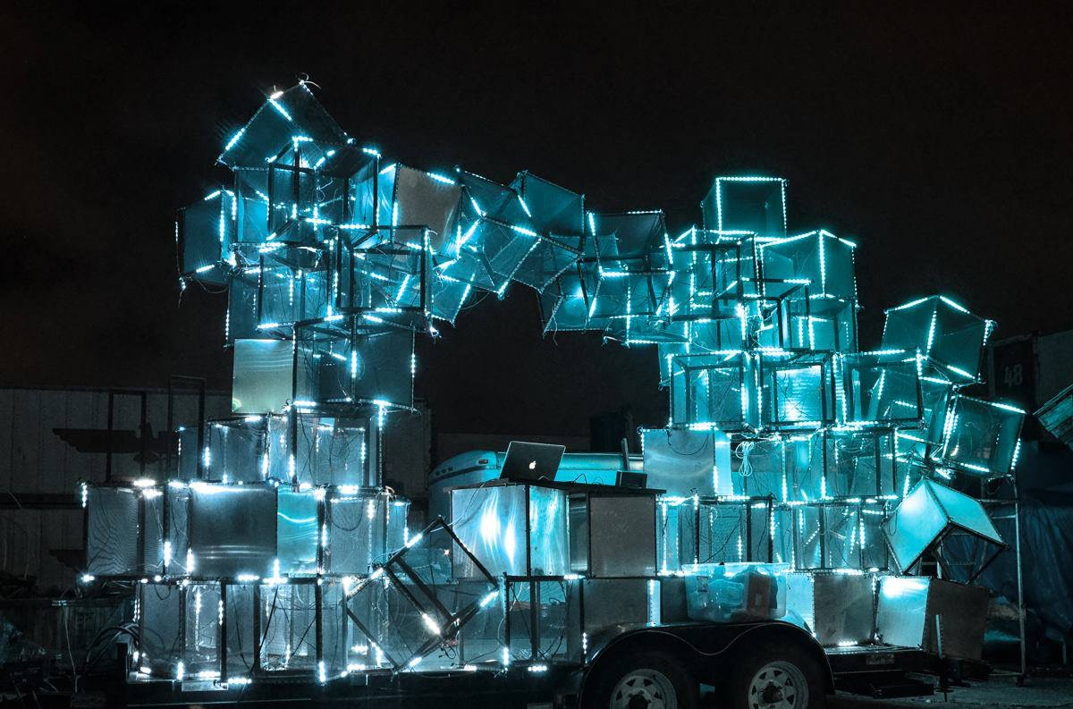

It started with a simple idea: to make lighting more like music
Notes:
MARKET SIZE
PURPOSE: The market for lighting in live shows is huge and growing
QUESTION: What is the market opportunity?

Slide 6
Lighting today isn't really controlled by algorithms
It’s either video or it’s “programmed” by sequences of switches, essentially hard coded in, using something like this
Notes:
MARKET SIZE
PURPOSE: The market for lighting in live shows is huge and growing
QUESTION: What is the market opportunity?

Slide 7
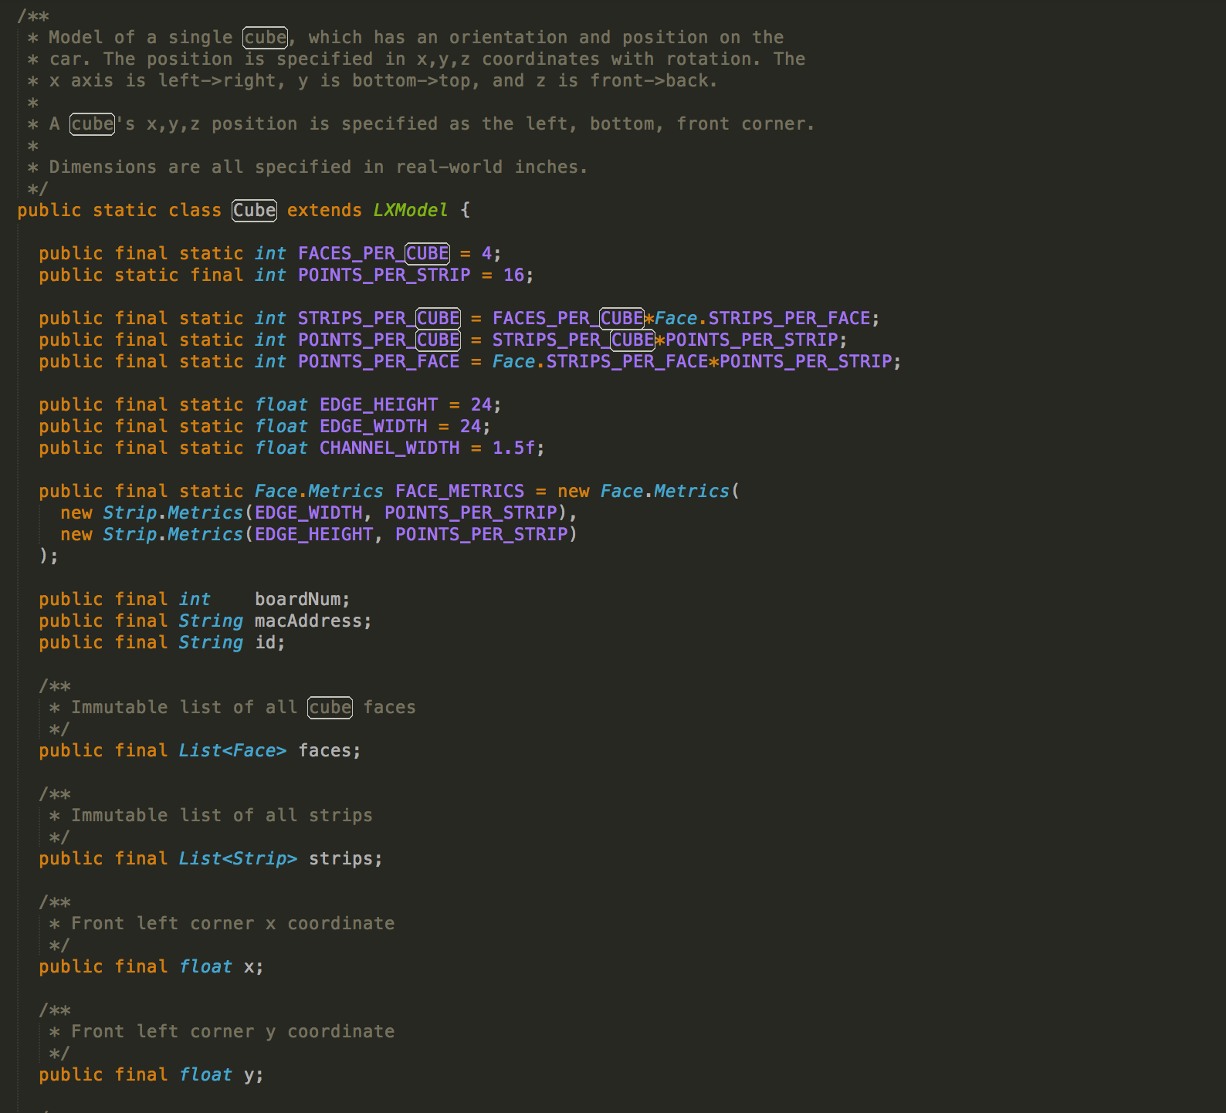
Abstractions are incredibly powerful!
Notes:
MARKET SIZE
PURPOSE: The market for lighting in live shows is huge and growing
QUESTION: What is the market opportunity?

Slide 8
Lighting today isn't really controlled by algorithms
It’s either video or it’s “programmed” by sequences of switches, essentially hard coded in, using something like this
Notes:
MARKET SIZE
PURPOSE: The market for lighting in live shows is huge and growing
QUESTION: What is the market opportunity?

Slide 9
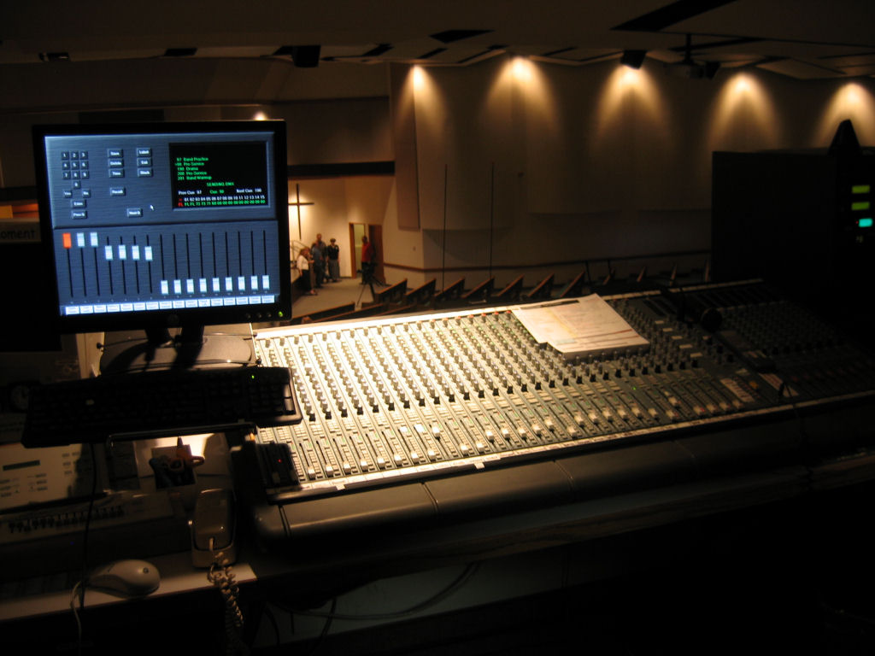

Slide 10
It started with a simple idea: to make lighting more like music
Notes:
MARKET SIZE
PURPOSE: The market for lighting in live shows is huge and growing
QUESTION: What is the market opportunity?

Slide 11
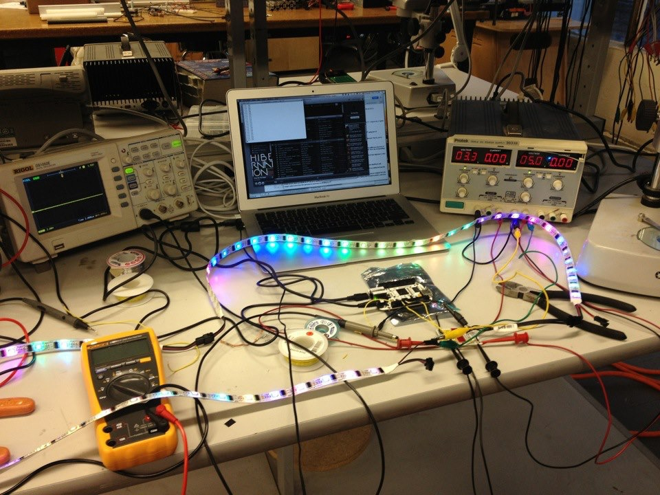
In reality, there was a lot of this
Notes:
MARKET SIZE
PURPOSE: The market for lighting in live shows is huge and growing
QUESTION: What is the market opportunity?

Slide 12
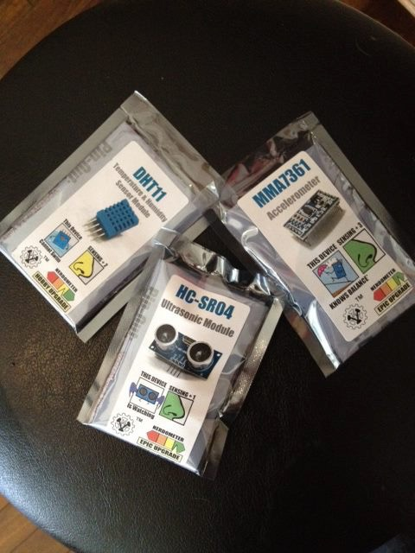
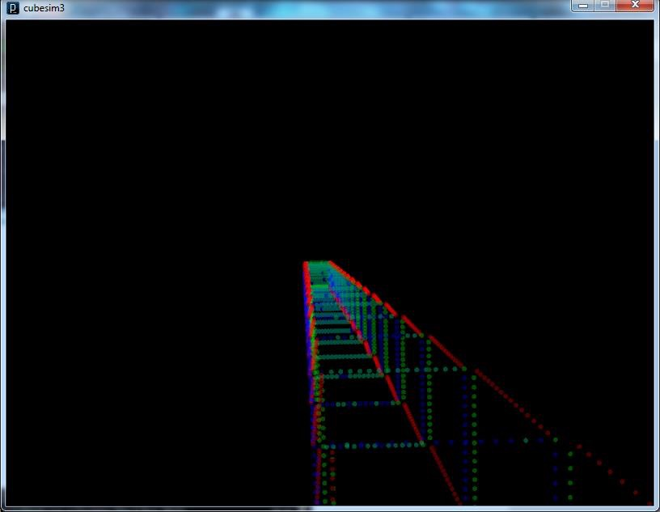
and this
Notes:
MARKET SIZE
PURPOSE: The market for lighting in live shows is huge and growing
QUESTION: What is the market opportunity?

Slide 13
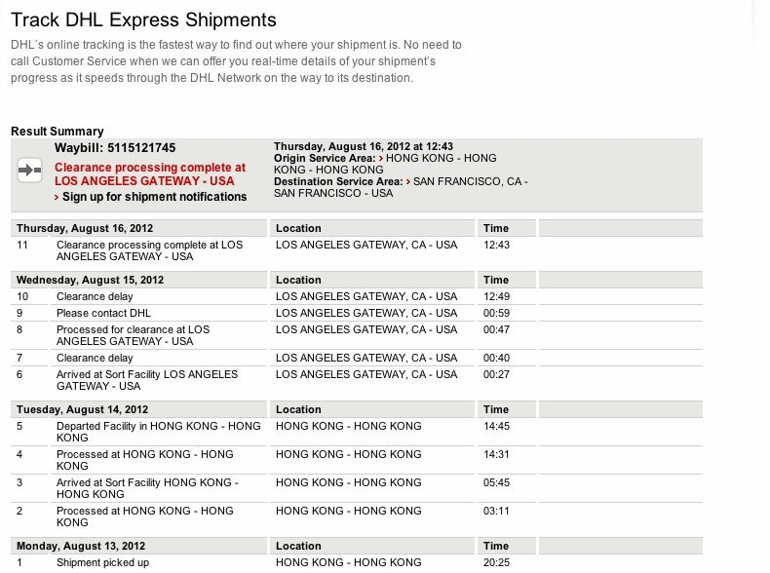
and this (Customs is a pain)
Notes:
MARKET SIZE
PURPOSE: The market for lighting in live shows is huge and growing
QUESTION: What is the market opportunity?

Slide 14
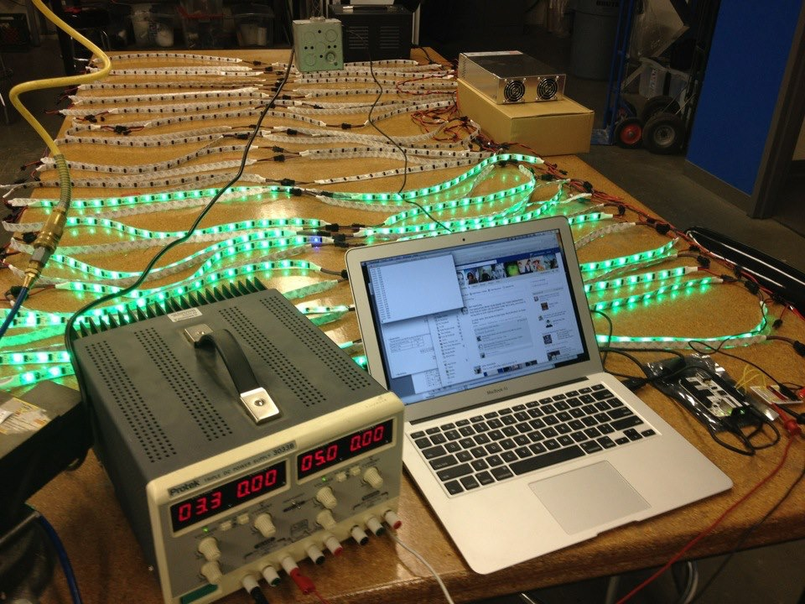
and this
and this
Notes:
MARKET SIZE
PURPOSE: The market for lighting in live shows is huge and growing
QUESTION: What is the market opportunity?

Slide 15
System Overview
Notes:
MARKET SIZE
PURPOSE: The market for lighting in live shows is huge and growing
QUESTION: What is the market opportunity?

Slide 16
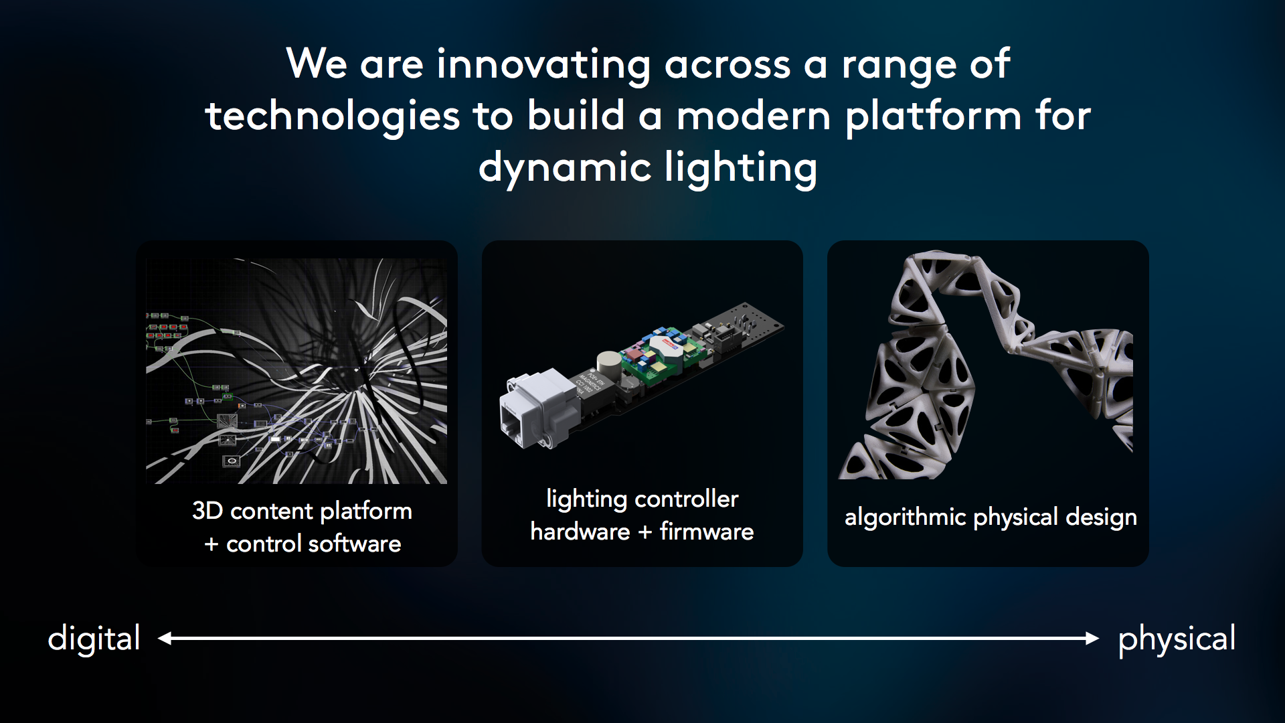
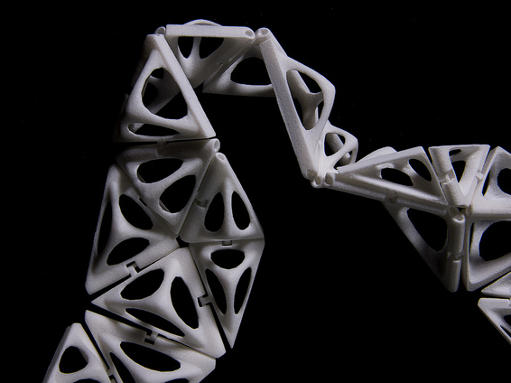
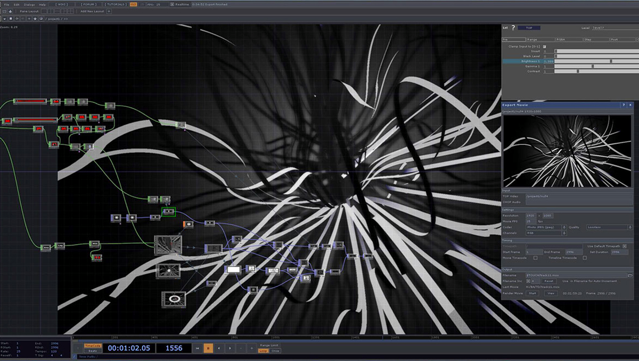
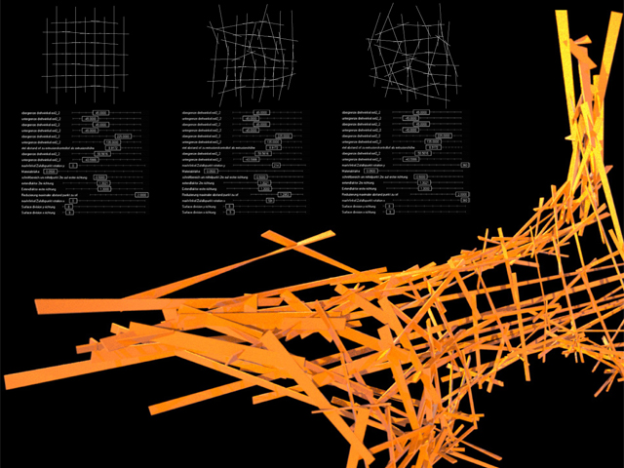
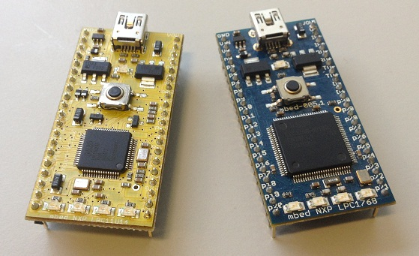
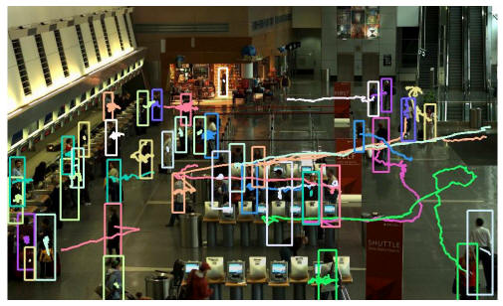
We are innovating across a range of technologies to enabling new types of dynamic lighting
distributed software
micro-controller
hardware and firmware
algorithmic physical design
computer vision
Notes:
MARKET SIZE
PURPOSE: The market for lighting in live shows is huge and growing
QUESTION: What is the market opportunity?

Slide 17
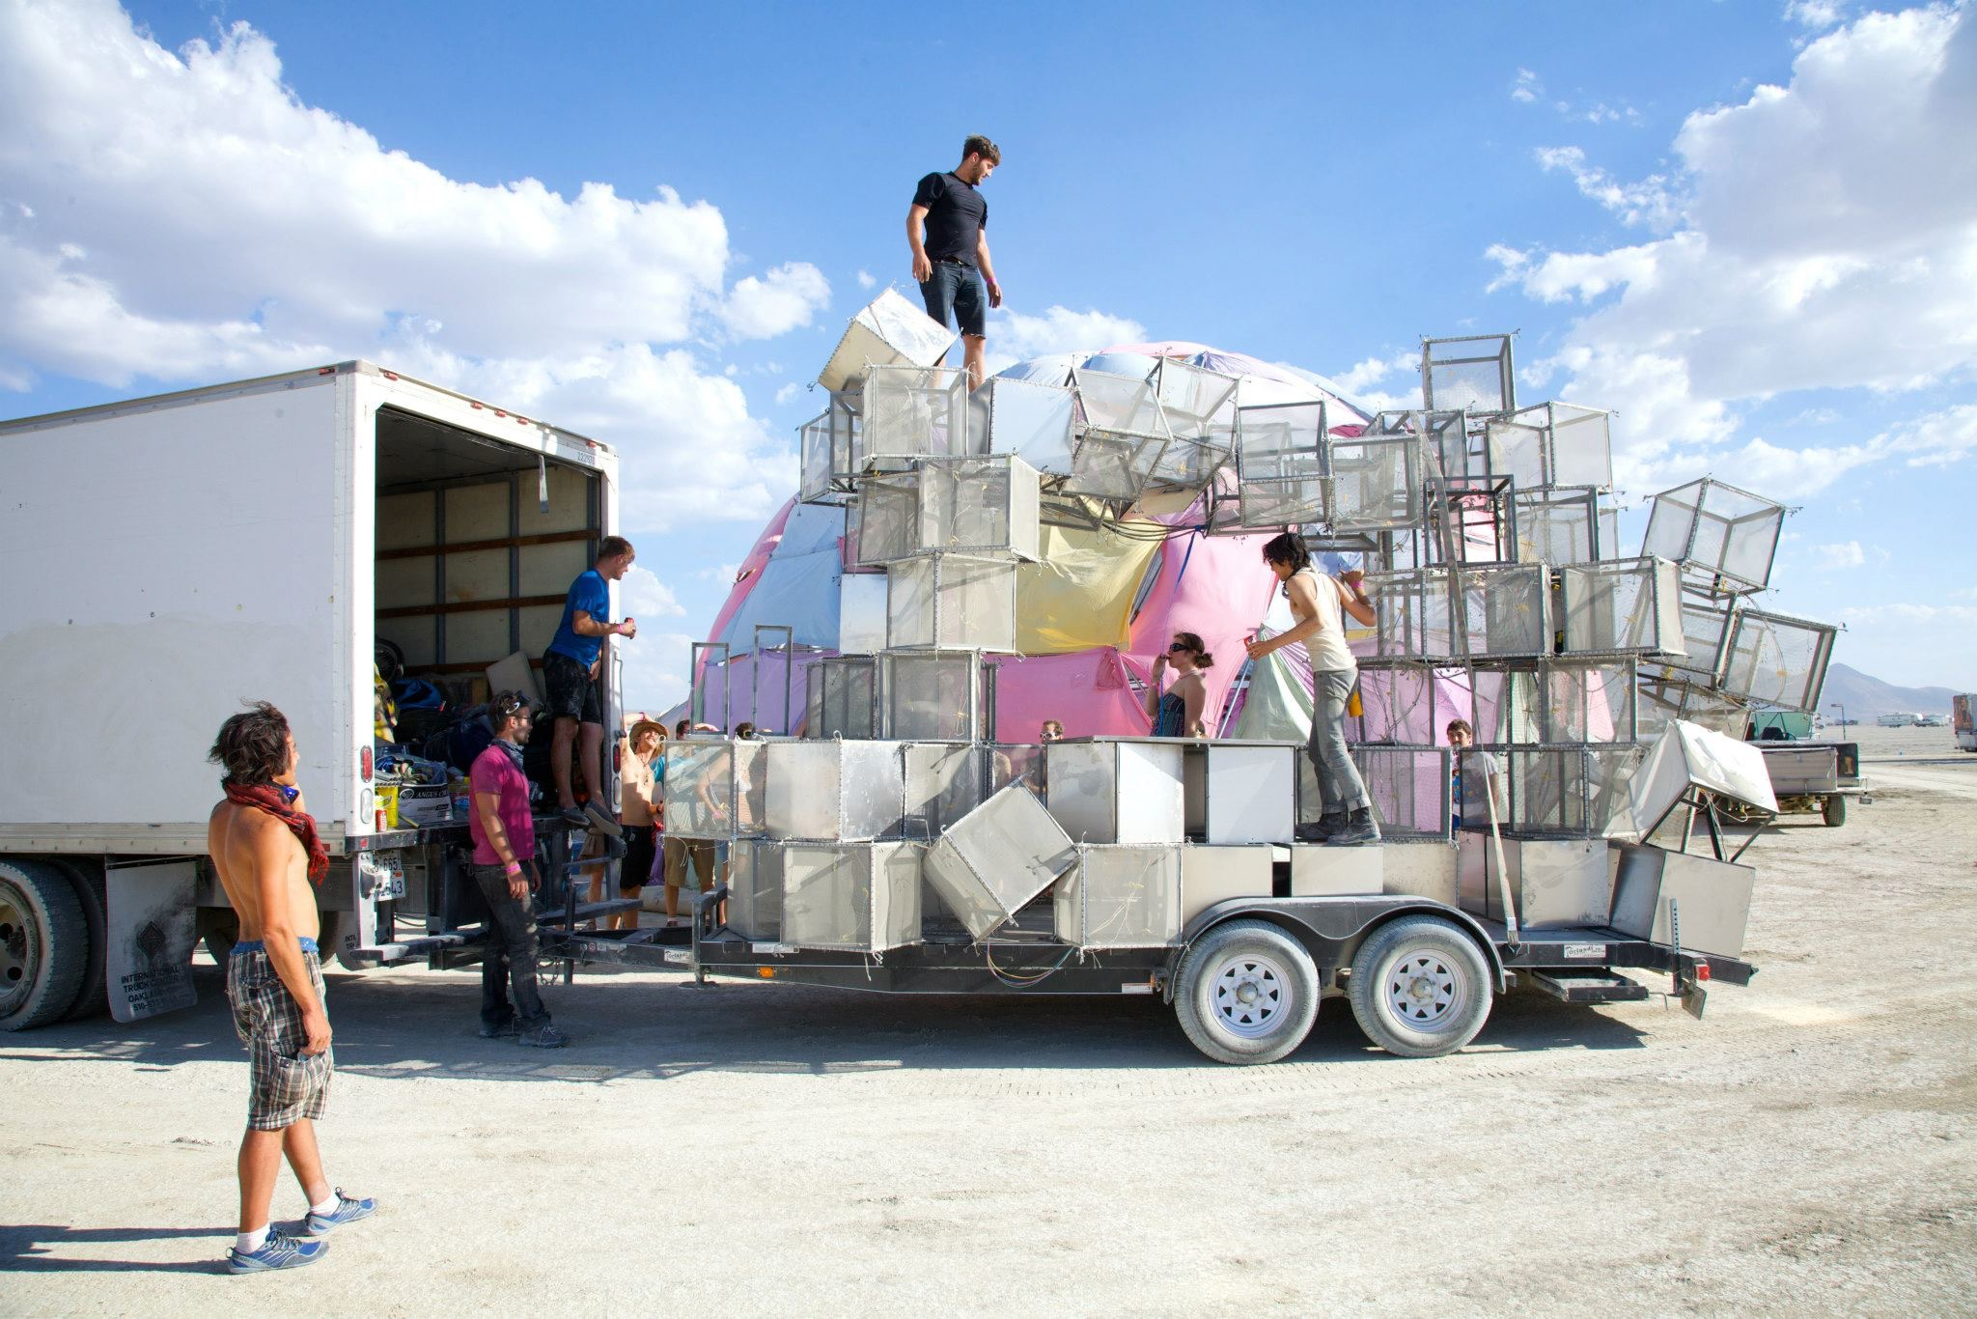
Notes:
MARKET SIZE
PURPOSE: The market for lighting in live shows is huge and growing
QUESTION: What is the market opportunity?

Slide 18
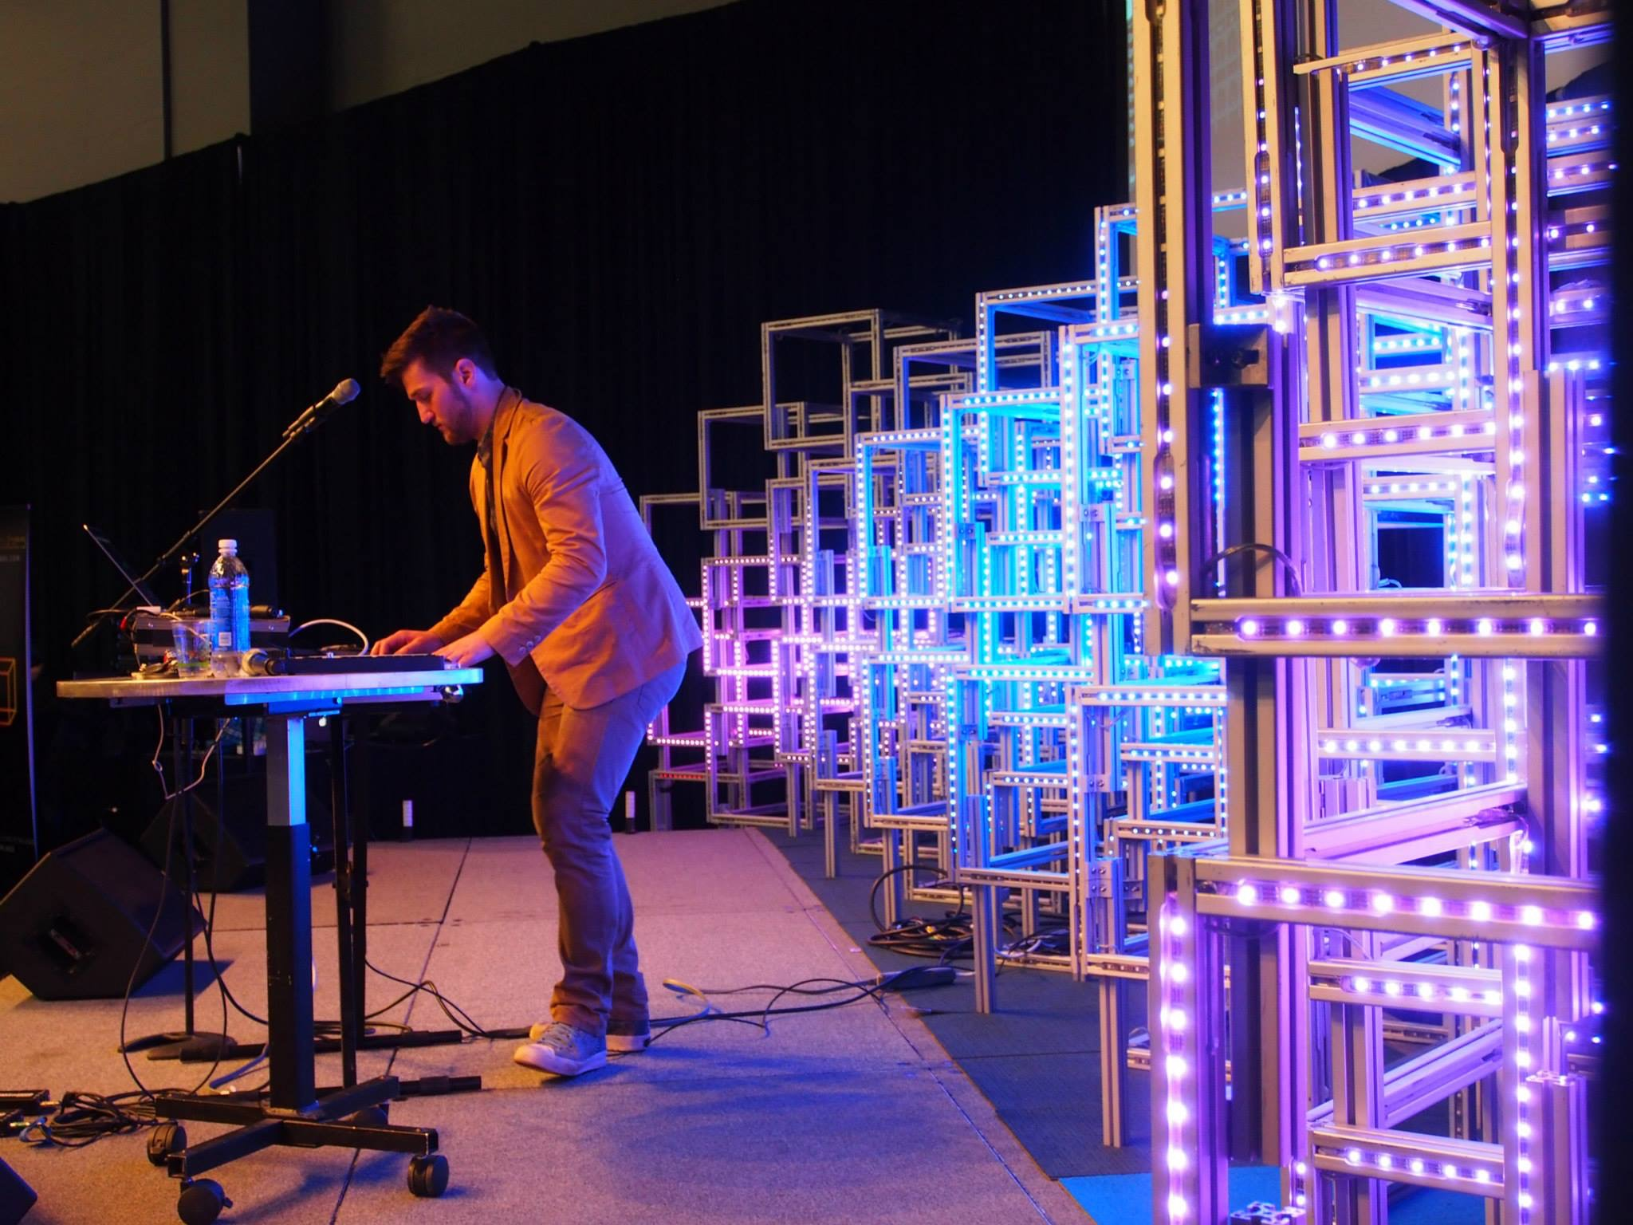
Notes:
MARKET SIZE
PURPOSE: The market for lighting in live shows is huge and growing
QUESTION: What is the market opportunity?

Slide 19
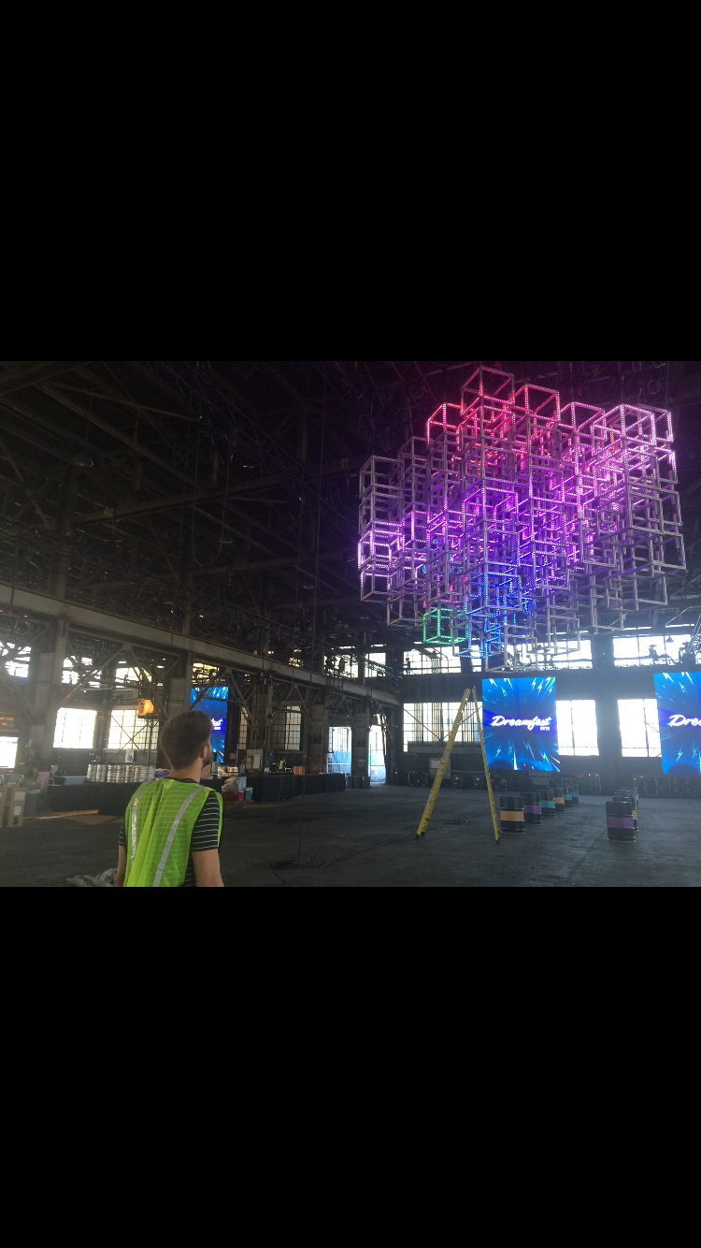
Notes:
MARKET SIZE
PURPOSE: The market for lighting in live shows is huge and growing
QUESTION: What is the market opportunity?

Slide 20
Switch to Kyle

Slide 21
Pipeline

Slide 22
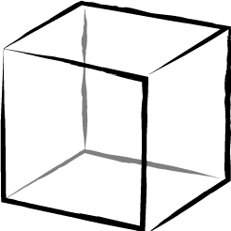
Sugar Cubes

Slide 23
Job is to Set “Pixels”
LED is like a pixel
Updated 60x per second

Slide 24


The Pipeline
Your Program
Computer -> Switch -> Pixel

Slide 25
The Pipeline
Your Program
Switch
Computer -> Switch -> Pixel

Slide 26
The Pipeline
Your Program
Switch
Computer -> Switch -> Pixel

Slide 27
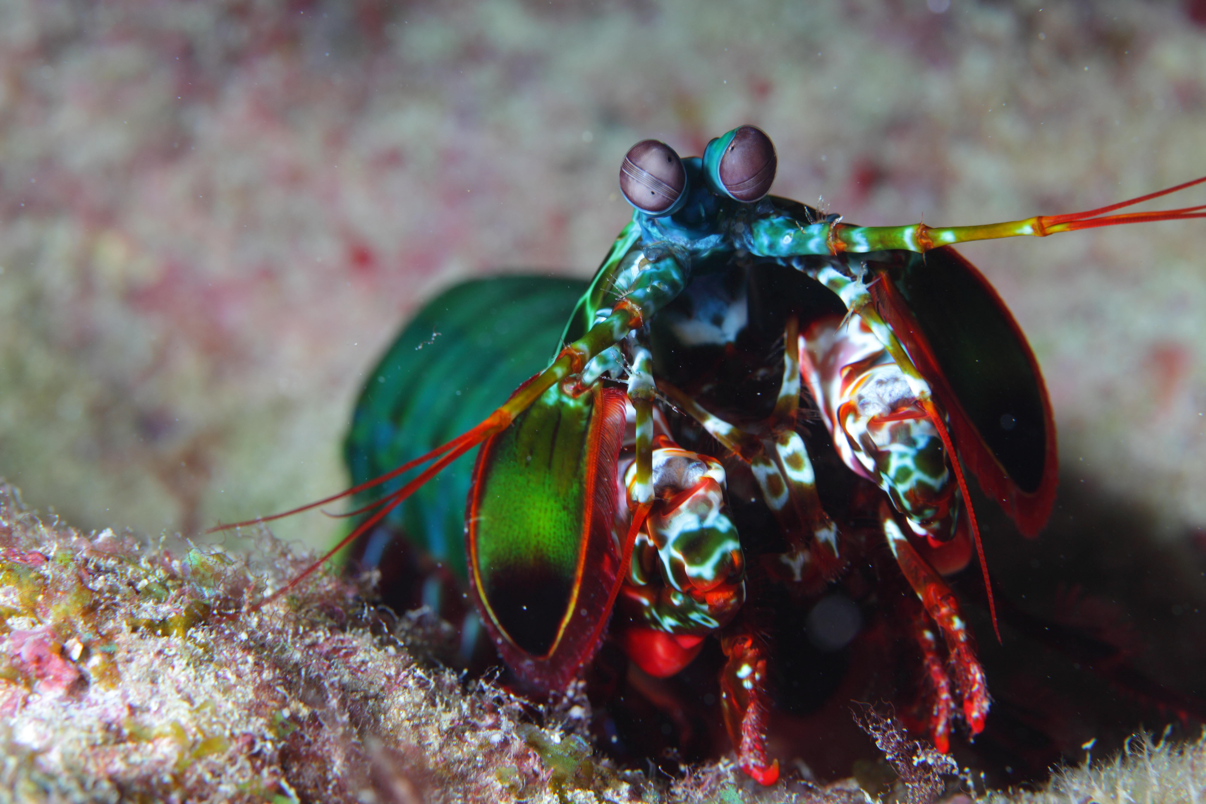
Colors

Slide 28
In Performance (Artistic Inputs)

Slide 29
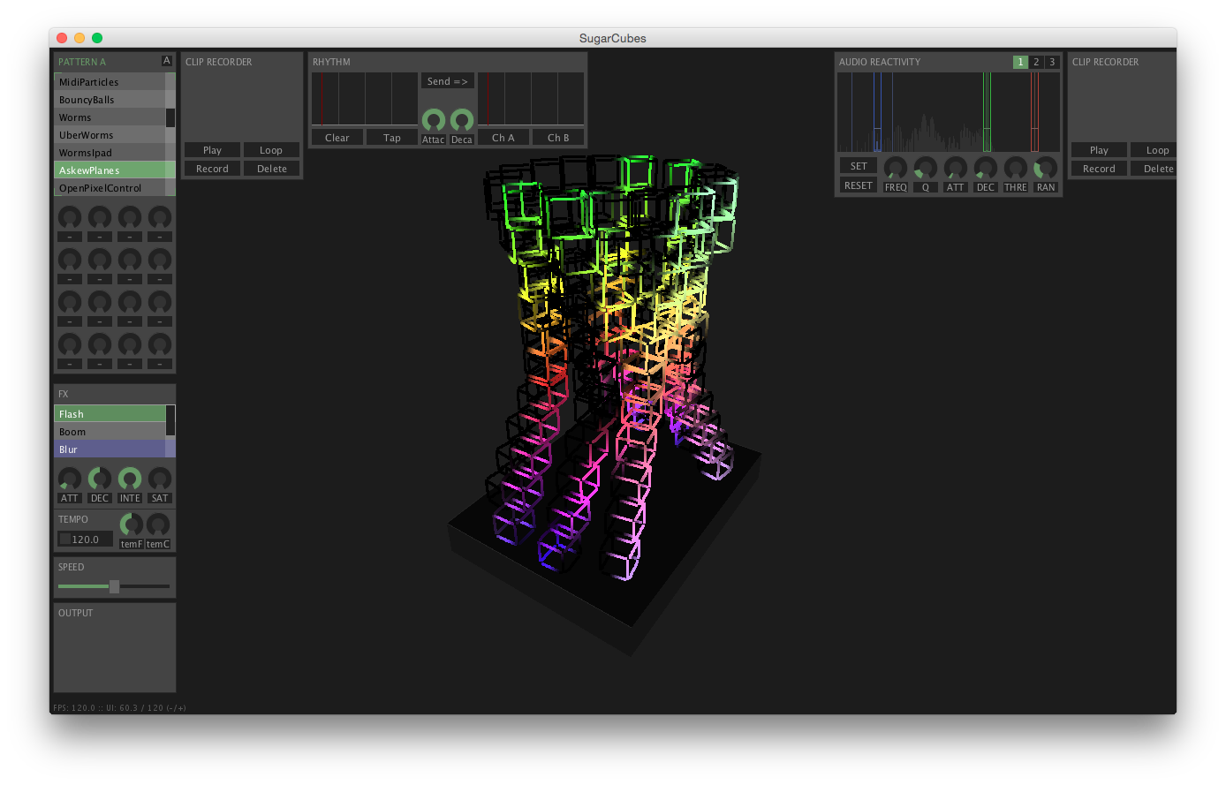
The Interface

Slide 30
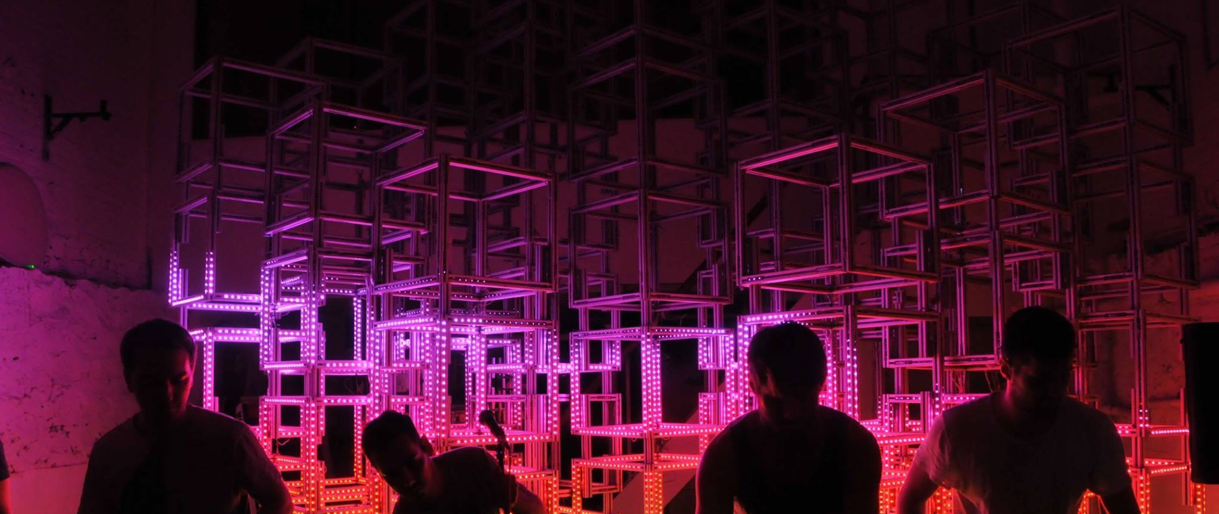

Slide 31
Switch to Chris

Slide 32
Alex + Kyle agreed to let us build in their codebase!
<your slides here>

Slide 33
Where we left off…

Slide 34

Listener Model
Artistic Program

Slide 35
Listener Model
Artistic Program

Slide 36
Listener Model
Artistic Program

Slide 37
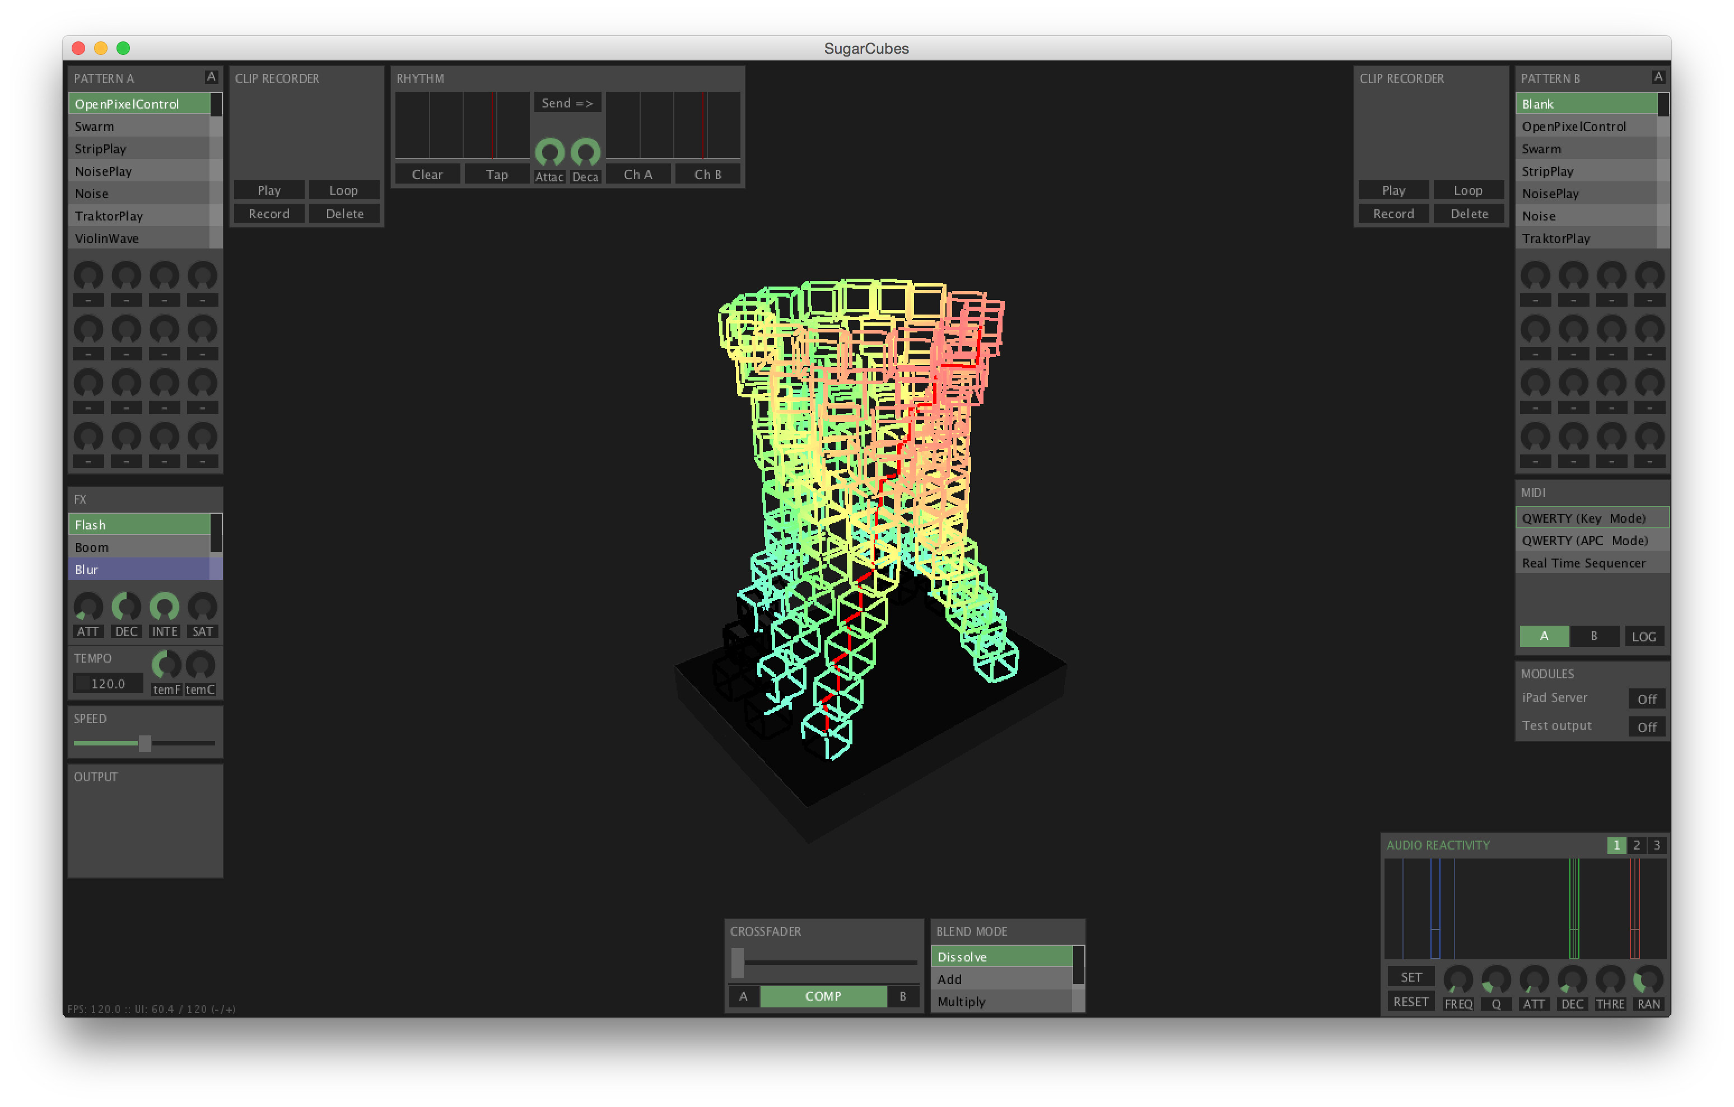

Listener Model
Artistic Program
Visualizer Program
Actual Cubes

Slide 38
Effect Class
Artistic Program

Slide 39


Effect Class
Artistic Program
New Effect Class
MyEffect.h
MyEffect.cpp

Slide 40
Effect Class
New Effect Class
MyEffect.h
MyEffect.cpp

Slide 41
Effect Class
New Effect Class
void onStart(allPixelData)
MyEffect.h
void beginFrame()
void shader(rgb, pixelInfo)
MyEffect.cpp
Passed by reference

Slide 42
Lets do it

Slide 43

C++ in the Wild

Slide 44
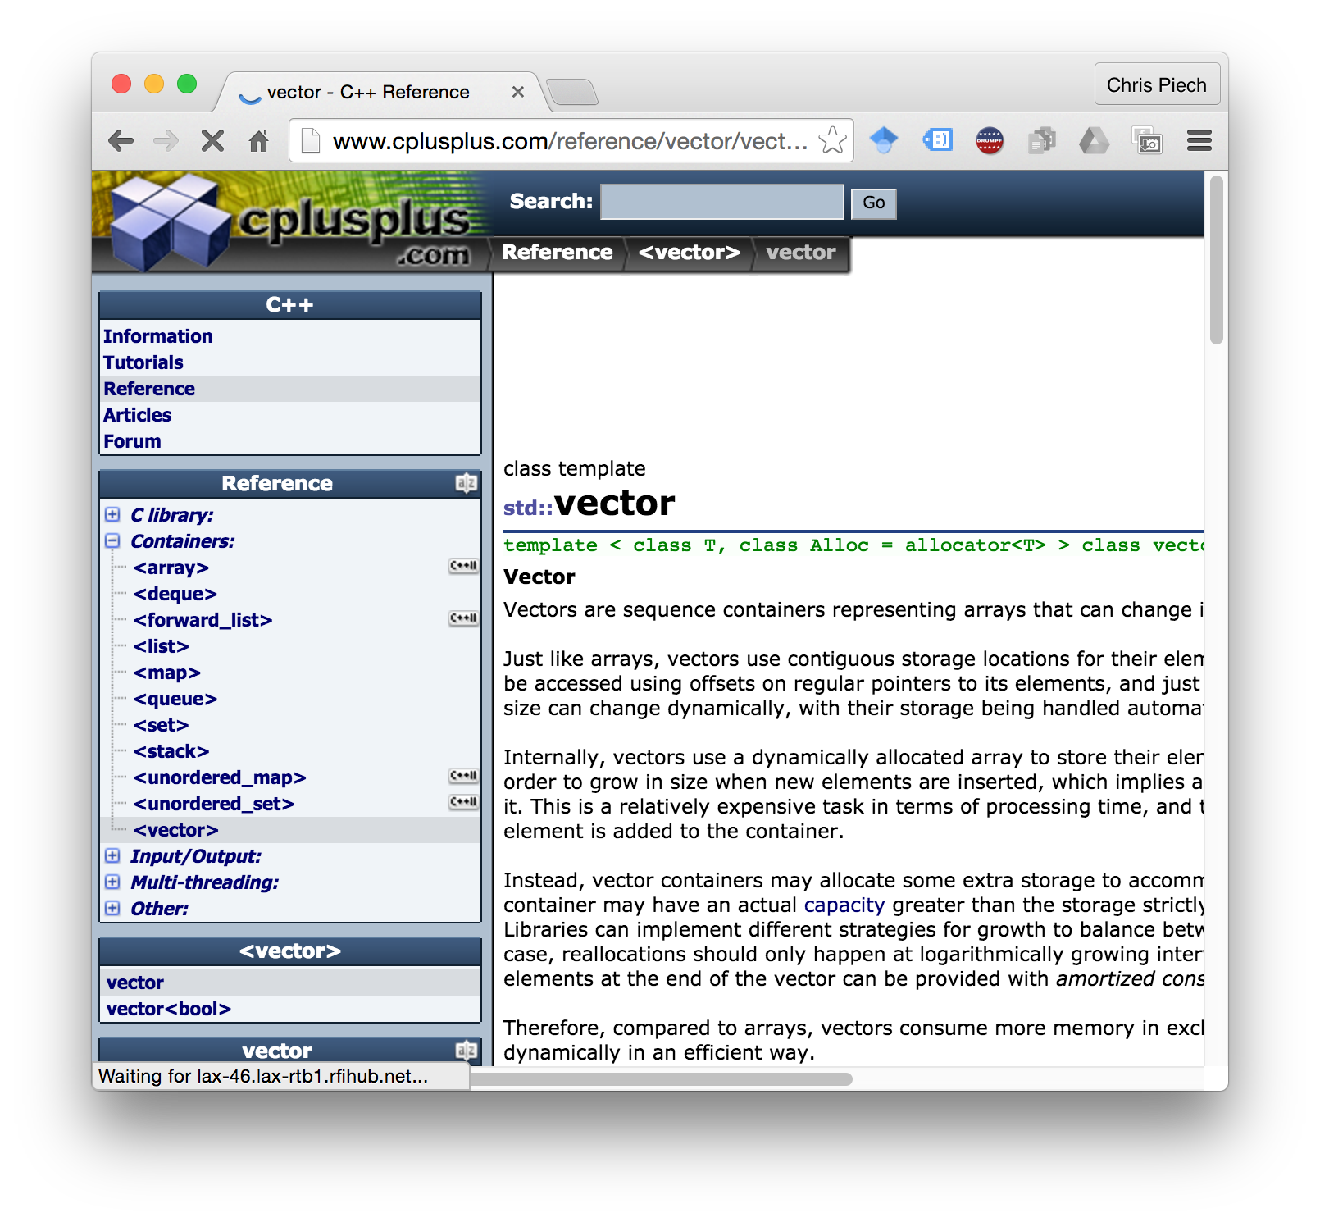
Standard Template Libraries
C++ in the Wild

Slide 45

Hue Saturation Value (HSV)

Slide 46
Hue Saturation Value (HSV)
[h = 0, s = 0.5, value = 1]

Slide 47
Hue Saturation Value (HSV)
[h = 0.4, s = 1.0, value = 0.5]

Slide 48
To the Code!

Slide 49
Today’s Goal
See “real” C++
Be inspired

